Slide 1
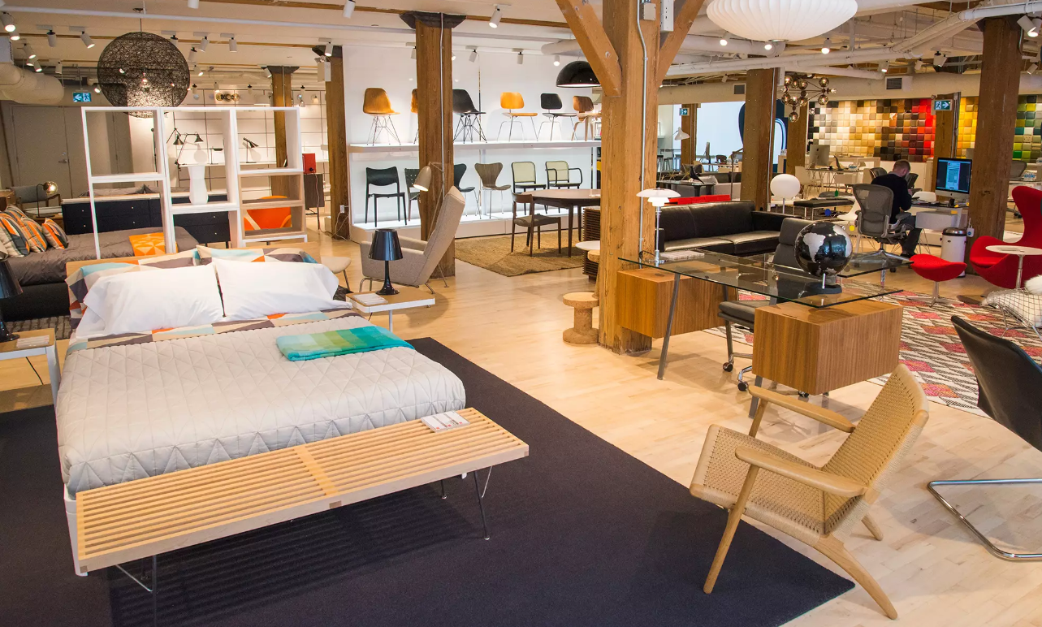
A Project on Retail Superstore

Slide 2
Contents
Introduction
Data Source
Data Cleaning
Creating a Data Base
Visualizing Reports and telling Stories using tableau
Using Linear Regression Model to Estimate Sales for the Future

Slide 3
1. Introduction
This project is about a retail store which has branches in various countries. The products are primarily furniture's, office supplies and appliances. The customers are broadly classified into three main categories i.e individuals, home office and corporate.
The data set available contains four years sales, quantities, shipping cost and profit.
The main objective of the project is to forecast sales and profit for the future based on last four years data using supervised machine learning, linear regression model to be more specific.

Slide 4
2. Data Source
We have used Kaggle.com to retrieve data set for the project.
Data set contains 24 columns and around 52K rows in flat file(csv).
The data points contains four years of sales and profit information which can be used to plot regression line and use supervised machine learning to create a model.
The machine learning model created can give the sales and profit forecast for the future period (y axis) when we put year and month in the X axis ( independent variable)

Slide 5
3. Data Cleaning
We will start with data cleaning activity by importing csv file to Jupyter notebook.
The data cleaning mainly entails, dropping columns with null values, inserting columns to have year and month information, converting date columns to datetime format, getting total value of the discount etc.
The analysis of data set to understand distribution of sales over various customer segment, products and countries.
Unearth any hidden relationship between sales, profit , products, discount and customer segments.

Slide 6
4. Creating a Data Base
After cleaning the data set, we will create a data base in Pg Admin .
A ERD diagram will be created to showing relationship between tables.
We will be creating , address table, product table,order ID table and category table.
After creating a tables, we will run a query to generate various reports like top 10 profitable products, top performing countries, profitability of shipping method vis a vis order priority etc.

Slide 7
5. Visualizing Reports and Telling Stories Using Tableau
The reports created in SQL (Pg Admin) will be used to visualize information in Tableau.
Based on various reports visualized, we will create a story, explaining facts about the superstore i.e displaying revenue growth over time, customer profit analysis, distribution of revenue over various geographical locations.
Visualize sales over time to display trend to understand which months of the year we have higher sales and which months are characterized as slow sales. This will help to plan stocking of inventories to ensure we are not overstocking inventories when sales are slow and not understocking when sales are more during specific month of the year.
We will present various what if scenario’s to explain what will be the profit if we change shipping mode, sales with and without discount etc.

Slide 8
6. Using Linear Regression Model to Estimate Sales for the Future
After we get a clean data set and understanding in depth the business trend, we will move on to predict sales forecast for the future.
Since data’s available for this project are continuous and have labels, we will use supervised learning model to predict sales for the future.
The most suitable model for this type of data set will be liner regression model. We will initiate a liner regression model to plot sales(y axis) over time(X axis) and get a line of best fit . We will implement our knowledge of liner regression from the weather forecast module where we tried to predict weather forecast.
After we create a liner regression model, we will use scikit-learn tool to train and test the model and get the accuracy and F score of the mode.
After we satisfy with the machine learning model, we will plot year and month in X axis to predict sales for the future. We will try this model to predict sales for each of the three customer segment separately.

Slide 9
Conclusion
This presentation serve a frame work for the project and guide team members to follow steps in order to achieve the milestones.
We will insert slides after we achieve each milestone to display outcome of the exercise.
………………………………….nothing follows------------------------------------------

